Slide 1





Supporting your Child’s Transition and Attachment to Secondary School
Part 3
Hully Wolderufael, Clinical Lead
Emma Fredman, Mental Health Clinician
Mental health support team (mhst)
Emotional Health Service
Achieving for Children
42 York Street
London TW1 3BW

Slide 2
Overview:
Reflecting on memories of primary school and saying goodbye
Staying in touch with friends
The importance of transitional objects
Providing children with a space to talk

Slide 3
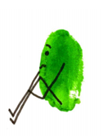
“But I’m going to miss primary school!”
Over the next months you might hear your child saying this.
It is important that they know this is ok.
We can normalise this for them and remind them that this is a big change and it’s ok to miss primary school. We can also help them to reflect on this further…

Slide 4
Reflecting on memories and taking next steps
What are they going to miss?
What are they ready to leave behind?
What are they taking with them?
What are they looking forward to?
Teachers
Friends
Being top of the school
Dependence on parent to get to school
Lots of knowledge
Skills to make friends
Confidence from accomplishments
New adventures
New friends
New subjects

Slide 5
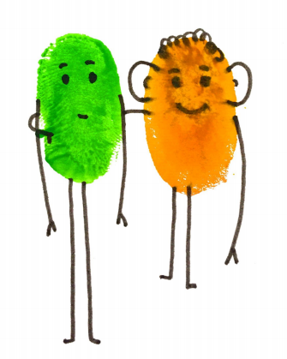
Staying in touch with old friends
It can be helpful to remind children that they can stay in touch with friends who are not moving on to the same school. This supports them to feel they maintain a connection to their primary school life and do not have to leave everything behind.
Encourage them to make time to see old friends outside of school
Support them to introduce old friends and new friends
Remind them to reach out to old friends, they are probably just as worried about losing old friends too.
Reassure them that even when we do not see people regularly a strong friendship can still be maintained

Slide 6
Transitional objects
Transitional objects are items used to provide psychological comfort, especially in new, unusual or unique situations.
You might recall that your child had a particular toy or blanket when they were younger which they took to nursery or helped them to get to sleep at night.
The reason that these objects provide comfort is because they act as a reminder to the child of the security provided by their attachment relationship. In the same way that being in your presence offered them a secure base from which to explore the world around them, their transitional object enabled them to maintain this sense of security even when you were not there as an extension of you.
Transitional objects can therefore support the development of autonomy and curiosity in addition to providing comfort in times of difficulty or distress.

Slide 7
Transitional objects
What can act as a transitional object for your child now during their move from primary to secondary school?
One idea is to have their teacher communicate in writing to them about:
A personal quality of your child
A strength of your child
An achievement your child has made
Although it might on the surface appear to be only a piece of paper, this document is imbued with the feelings shared between teacher and student, and holds the memories of the accomplishments and developments made at this stage of their life.
It can act as a reminder to them of all they have achieved and bolster their confidence and security to enable their natural curiosity to shine through as they take the next step in their journey.

Slide 8

Offering a space for your child to talk
Don't be afraid to approach the child and ask if they are OK or if something is bothering them
Listening is the best support you could offer
Wonder aloud about what might be happening for the child
Name feelings around events if they approach you to talk.
Look beyond behaviour, be curious about what may happening for them.
Model emotional regulation

Slide 9
Summary:
Reflecting on memories of primary school and saying goodbye
Staying in touch with friends
The importance of transitional objects
Providing children with a space to talk

Slide 10

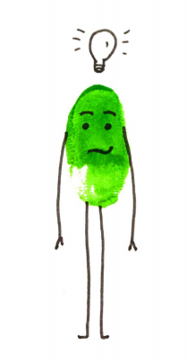
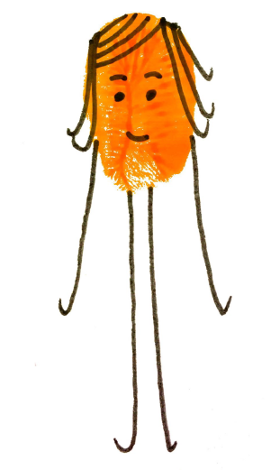
Questions - Ideas - Feedback
Contact us on: MHST@achievingforchildren.org.uk

Slide 11


