Slide 1

End of Key Stage 1
Assessments
30th January 2019

Slide 2
What are SATs?
ED
The National Curriculum assessments at the end of Key Stages 1 and 2 are designed to give you and your child’s school information about how well your child is doing.
At Key Stage 1 the level will be based on the teacher's assessment, involving ongoing assessment of children’s work. It also takes into account your child’s performance in several SATs assessments.

Slide 3
National Curriculum Assessment Changes
ED
In 2014/15 a new national curriculum framework was introduced by the Government.
Children in all years at Key Stage 1 and 2 are expected to study the new national curriculum.
2015/2016 the KS1 (Year 2) and KS2 SATs (Year 6) reflected the new curriculum for the first time.
TAFs – Teacher Assessment Frameworks.

Slide 4
Assessment and Reporting
ED
Your child will still be taught with the highest expectations and cover all required elements of the curriculum.
The new curriculum is more rigorous and sets high expectations which all schools have had to work hard to meet since it was introduced.
At Key Stage One teacher assessment is the most important way we assess your child.
Your child has been following the new curriculum ever since the beginning of Year 1 and this is what they will be assessed on.
SATs tests are used to support our teacher assessments and help to ensure that we are assessing consistently as a school and in line with other schools.
During the Spring and Summer Terms, Year 2 teachers have been and will be attending a number of moderation sessions with other schools from Richmond to ensure that our teacher judgements, particularly in writing, are consistent with other schools.

Slide 5
Reading
EJ
The most crucial aspects of reading at the end of Key Stage 1 are:
Accuracy (decoding familiar and un familiar words correctly)
Fluency (speed and confidence)
Comprehension (drawing meaning from text)
Guided reading
Book bands

Slide 6
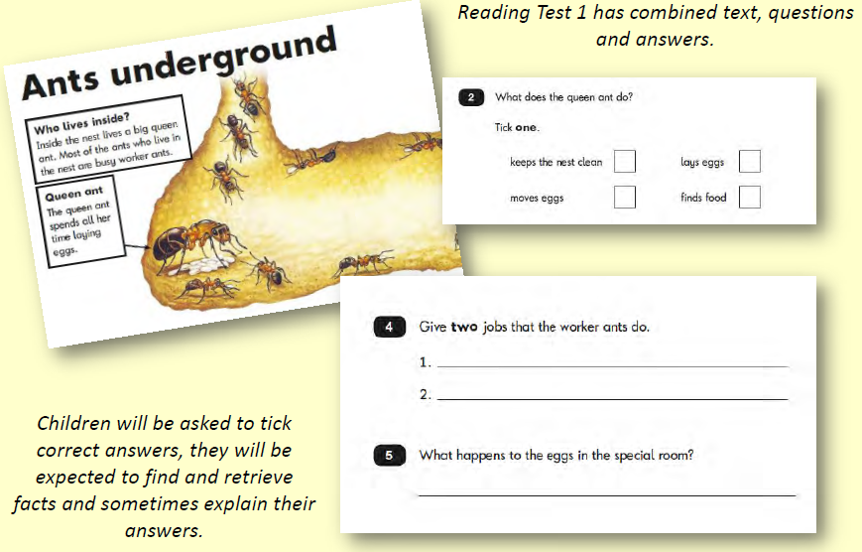
Sample reading questions
EJ

Slide 7
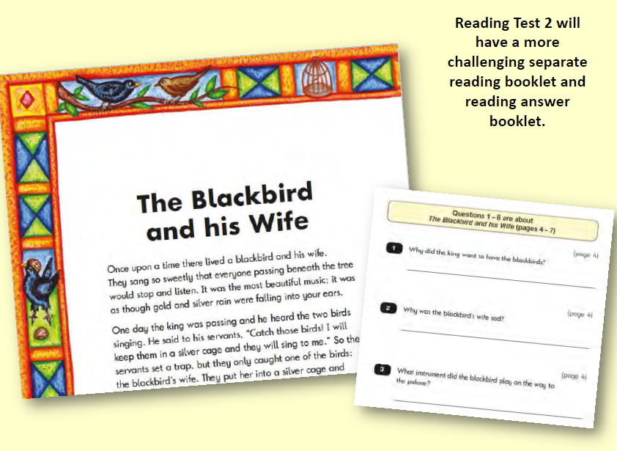
EJ

Slide 8
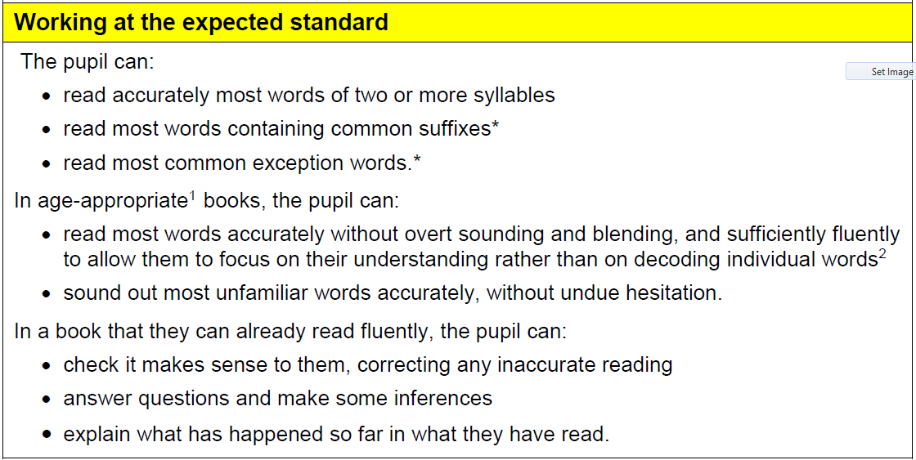
EJ
Reading - Expected

Slide 9
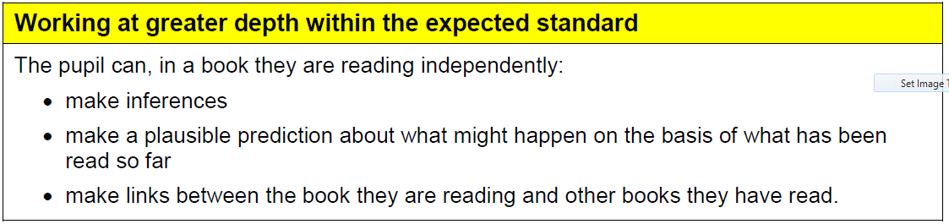
EJ
Reading – Greater Depth

Slide 10
How to Help Your Child with Reading
EJ
Listening to your child read can take many forms:
First and foremost, focus developing an enjoyment and love of reading.
Enjoy reading together – reading stories, non fiction, magazines, comics etc. Reading to your child is equally as important as listening to your child read.
Read a little at a time but often, rather than rarely but for long periods of time!
Discuss their reading before, during and afterwards – If reading a story discuss the plot, the characters, their feelings and actions, how it makes you feel, predict what will happen and encourage your child to have their own opinions. For non-fiction texts discuss the features and what they now know that they didn't already.
Look up definitions of words together – you could use a dictionary, the Internet or an app on a phone or tablet.
All reading is valuable – it doesn’t have to be just stories. Reading can involve anything from fiction and non-fiction, poetry, newspapers, magazines, football programmes.
Encourage your child to use Bug Club. There are lots of exciting books and comprehension activities to support.
Visit the local library - it’s free!

Slide 11
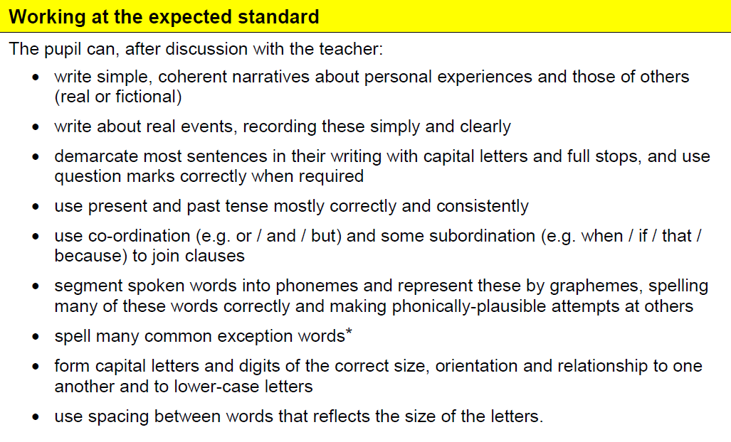
Writing - Expected
ML

Slide 12
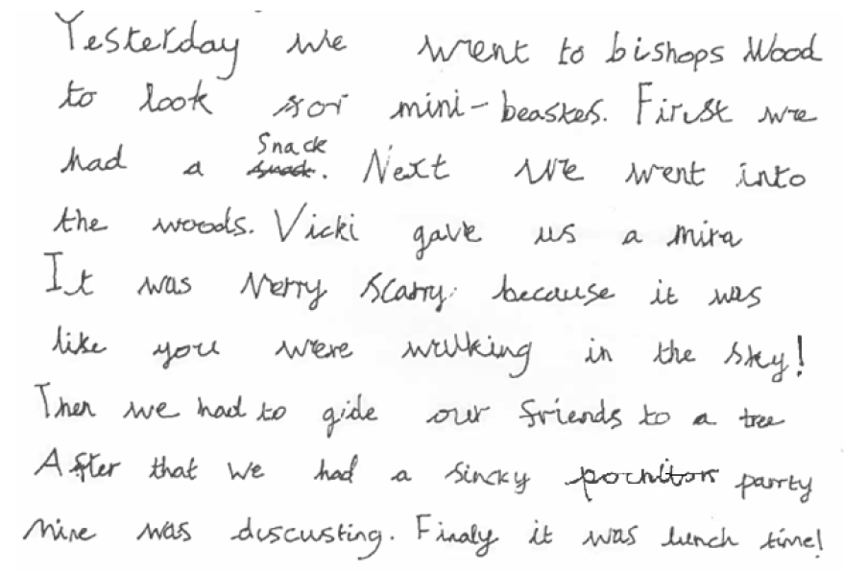
ML

Slide 13
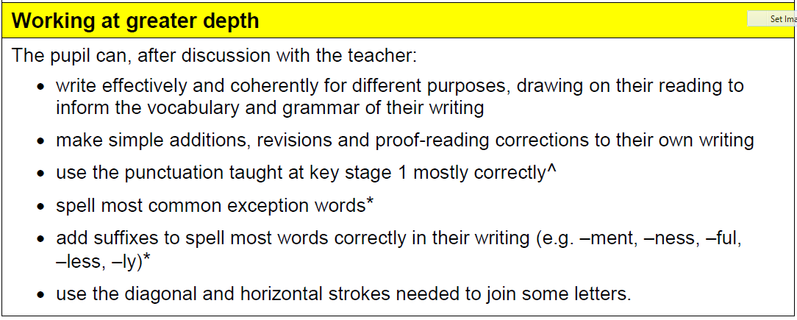
ML
Writing – Greater Depth

Slide 14
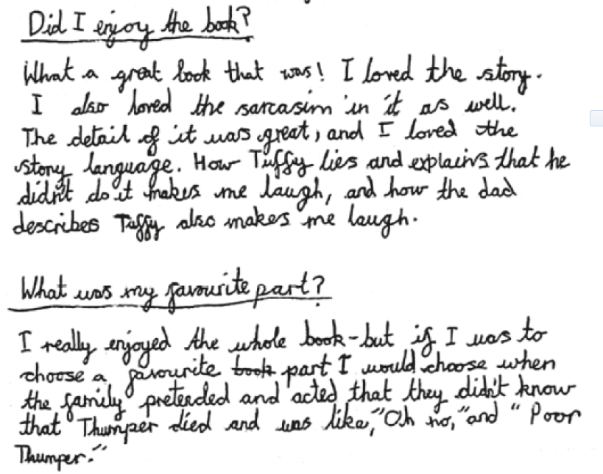
ML

Slide 15
Writing – how to help at home.
ML
Practise and learn weekly spelling lists – make it fun! We have a new system for spellings at home.
Encourage opportunities for writing, such as letters to family or friends, shopping lists, notes or reminders, stories or poems.
Write together – be a good role model for writing.
Encourage use of a dictionary to check spelling.
Allow your child to use a computer for word processing, which will allow for editing and correcting of errors without lots of crossing out.
Remember that good readers become good writers! Identify good writing features when reading (e.g. vocabulary, sentence structure, punctuation).
Show your appreciation: praise and encourage, even for small successes!

Slide 16
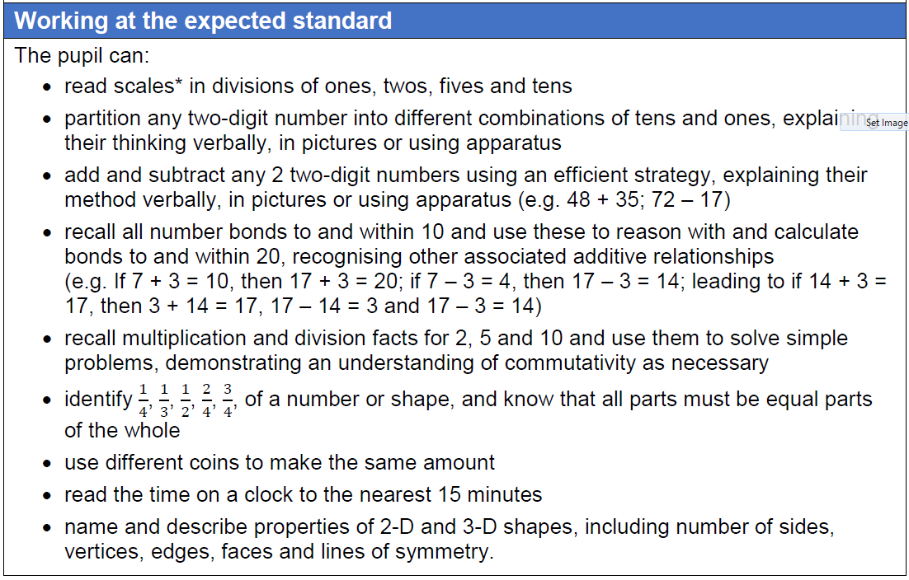
FH
Maths - Expected

Slide 17
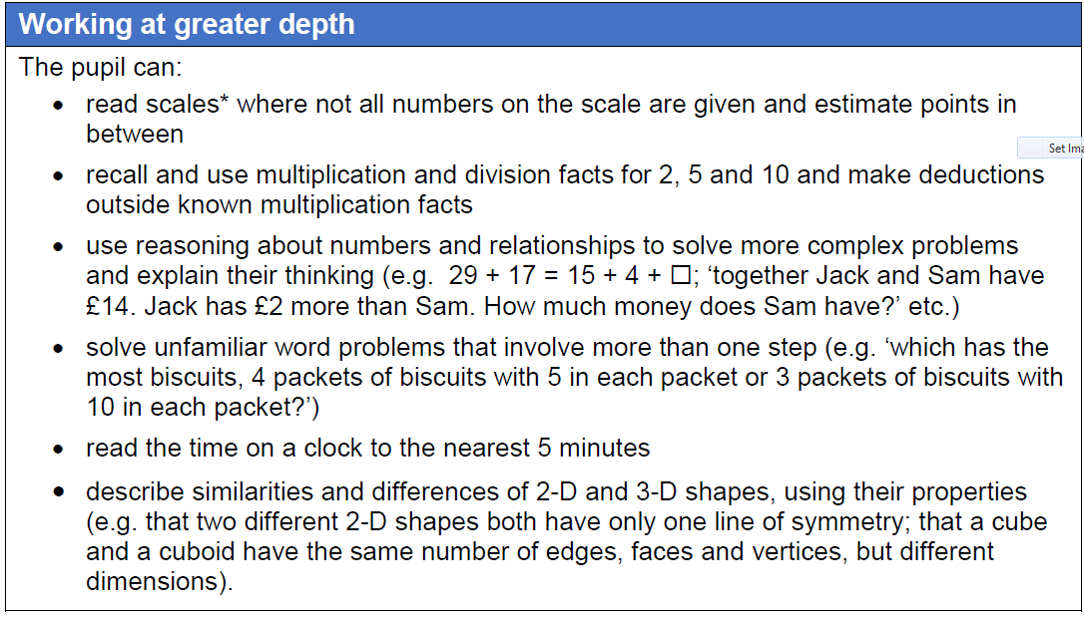
FH
Maths – Greater Depth

Slide 18
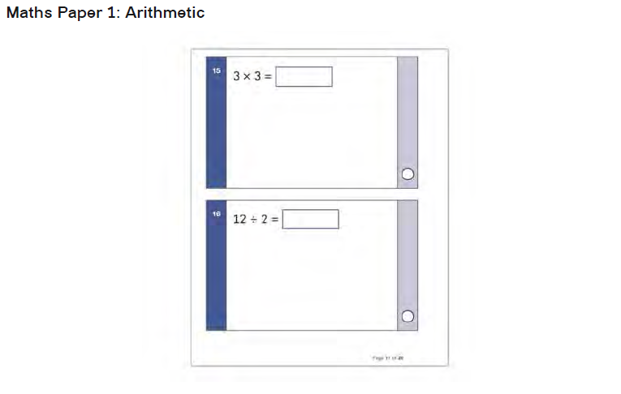
Maths
FH

Slide 19
Maths
FH

Slide 20
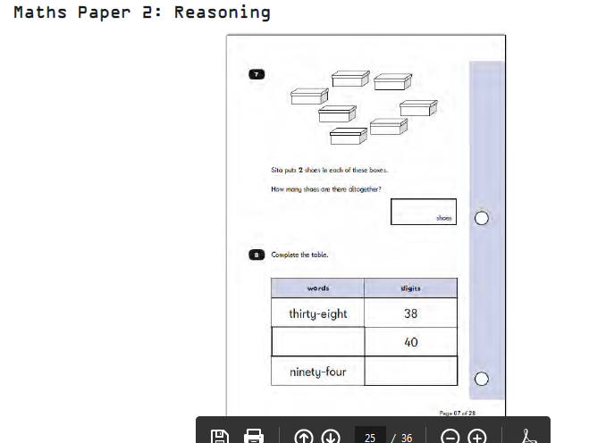
Maths
FH

Slide 21
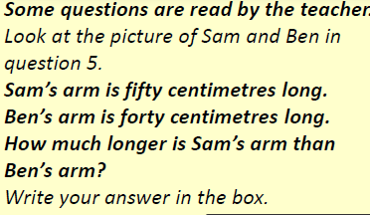
Maths
FH

Slide 22
How to Help Your Child with Maths
FH
Play times tables games.
Play mental maths games including counting in different amounts, forwards and backwards.
Encourage opportunities for telling the time.
Encourage opportunities for counting coins and money e.g. finding amounts or calculating change when shopping.
Look for numbers on street signs, car registrations and anywhere else.
Look for examples of 2D and 3D shapes around the home.
Identify, weigh or measure quantities and amounts in the kitchen or in recipes.
Play games involving numbers or logic, such as dominoes, card games, draughts or chess.
Encourage EXPLANATION!

Slide 23
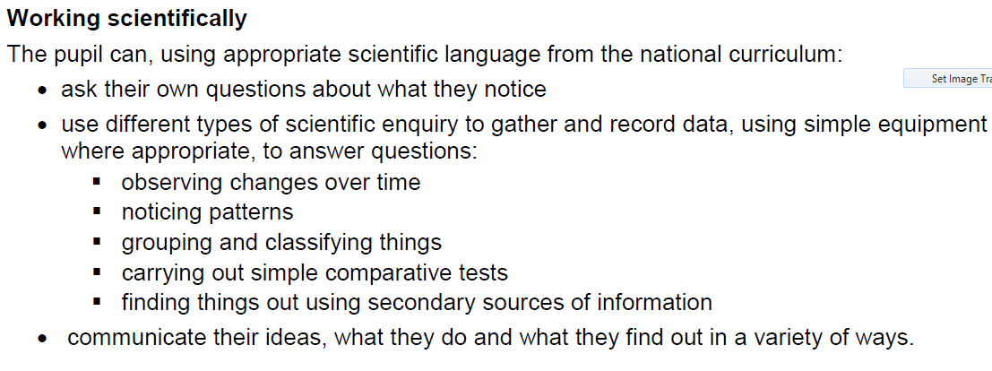
Science - skills
FH

Slide 24
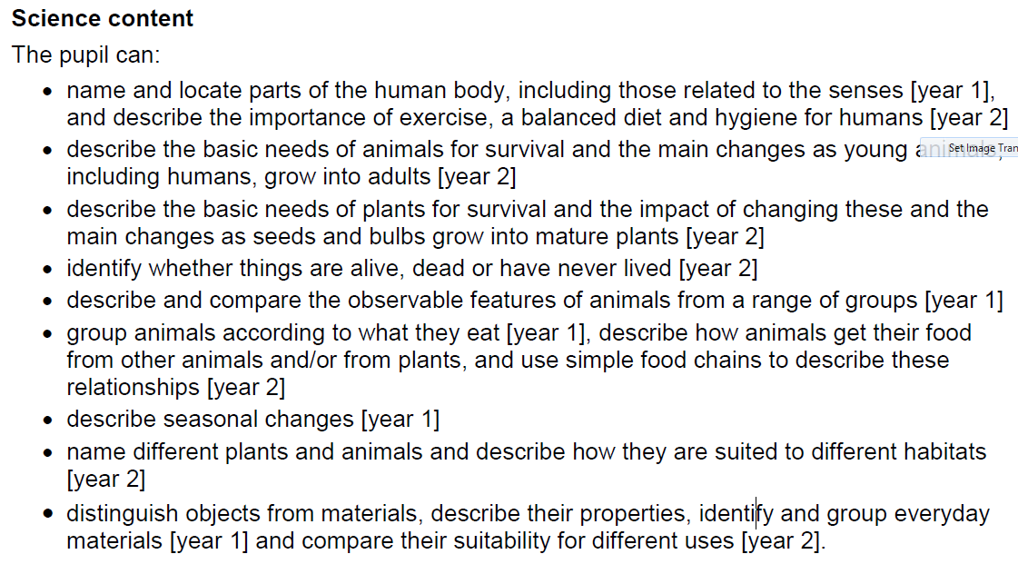
Science
FH

Slide 25
Reporting KS1 outcomes
ED
Children’s attainment will be measured and reported on in school performance tables.
Teacher assessments will be passed on to Year 3 so that these can be used in planning for KS2 teaching.
Written reports are given at the end of the Summer term.

Slide 26
How are we preparing?
ED
Continuous ongoing teacher assessment
Focused Maths learning
Focused Spelling learning – rules and strategies to remember
Focused English grammar, spelling and punctuation lessons
Guided and Independent reading
Practising previous SATs questions
Supporting the children with strategies for answering questions
Keeping up to date with all National guidance
Miss Dayton is now a moderator for the local authority working with the moderation team

Slide 27
How to help at home…
ED
First and foremost, support and reassure your child that there is nothing to worry about and that they should always just try their best. Praise and encourage!
Ensure your child has the best possible attendance at school and arrive on time!
Reading, spelling and arithmetic (e.g. times tables) are always good to practise.
Talk to your child about what they have learnt at school and what book(s) they are reading (the character, the plot, their opinion).
Make sure your child has a good sleep and healthy breakfast every morning!
Parents’ evening in March is an opportunity to discuss your child’s individual progress in more detail.

