Slide 1
LIFE/work balance
We have started a #LIFEworkbalance campaign and we need your help to complete our LIFE/work balance survey.
We hope to publish the results soon, so please give 15 minutes of your time to help us get a true picture of school life.
Want to be a part of this campaign? Take the survey on our website and share it with your colleagues!
© Classroom Secrets Limited 2020

Slide 2
Year 1 – Spring Block 2 – Place Value – Numbers to 50
About This Resource:
This PowerPoint has been designed to support your teaching of this small step. It includes a starter activity and an example of each question from the Varied Fluency and Reasoning and Problem Solving resources also provided in this pack. You can choose to work through all examples provided or a selection of them depending on the needs of your class.
National Curriculum Objectives:
Mathematics Year 1: (1N1a) Count to and across 100, forwards and backwards, beginning with 0 or 1, or from any given number
Mathematics Year 1: (1N2a) Count, read and write numbers to 100 in numerals
More Year 1 Place Value resources.
Did you like this resource? Don’t forget to review it on our website.
© Classroom Secrets Limited 2019

Slide 3
Year 1 – Spring Block 2 – Place Value
Step 1: Numbers to 50
© Classroom Secrets Limited 2019

Slide 4
Introduction
Lily is counting forwards from 30 to 42. Has she counted correctly?
30, 31, 33, 34, 35, 36, 37, 38, 39, 41, 42…
© Classroom Secrets Limited 2019

Slide 5
Introduction
Lily is counting forwards from 30 to 42. Has she counted correctly?
No, she has missed the numbers 32 and 40.
30, 31, 32, 33, 34, 35, 36, 37, 38, 39, 40, 41, 42…
© Classroom Secrets Limited 2019

Slide 6
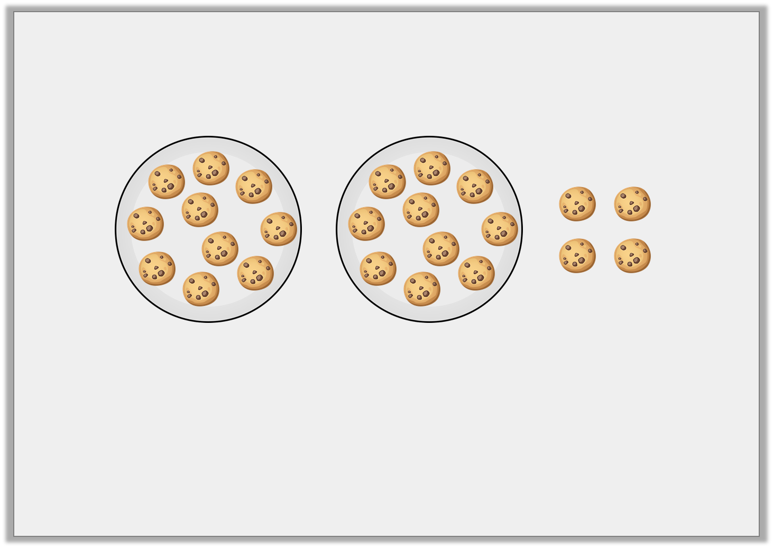
Varied Fluency 1
Each plate holds 10 cookies.
How many cookies are there altogether?
© Classroom Secrets Limited 2019

Slide 7
Varied Fluency 1
Each plate holds 10 cookies.
How many cookies are there altogether?
24
© Classroom Secrets Limited 2019

Slide 8
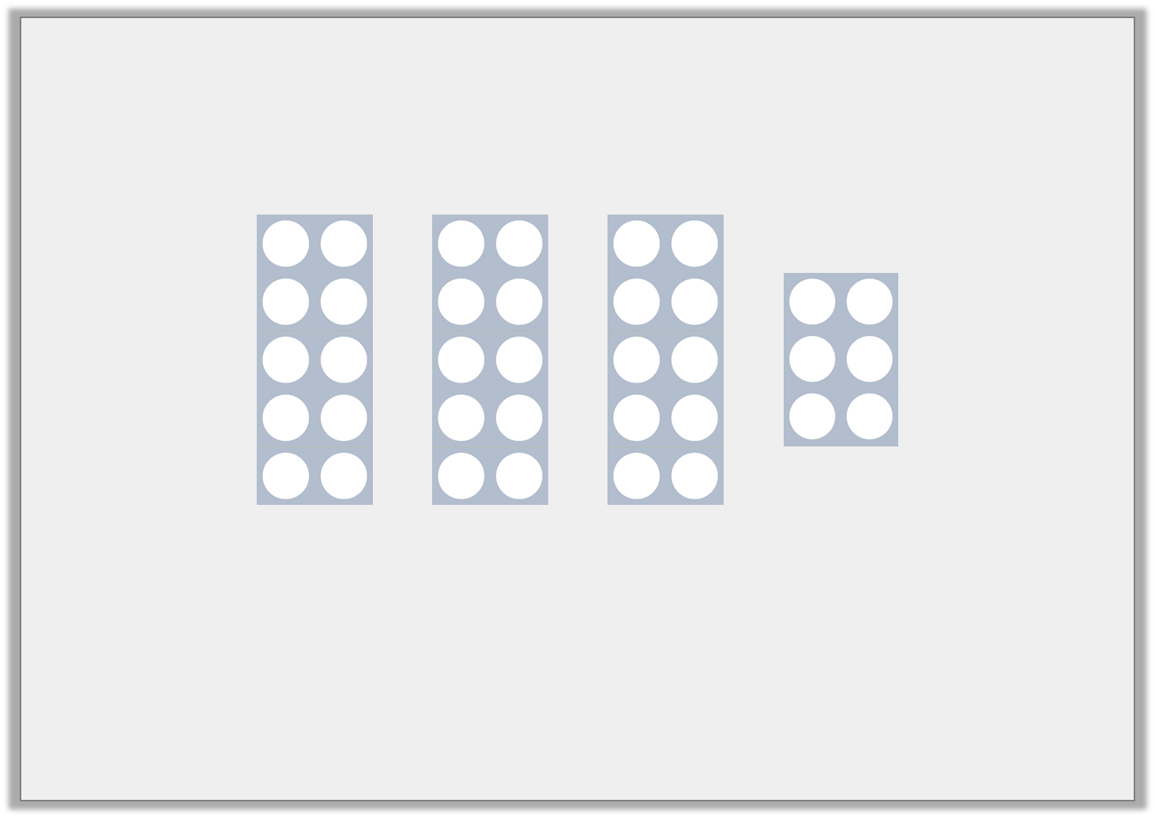
Varied Fluency 2
Circle the number shown below.
27 | 48 | 36
© Classroom Secrets Limited 2019

Slide 9
Varied Fluency 2
Circle the number shown below.
27 | 48 | 36
© Classroom Secrets Limited 2019

Slide 10
Varied Fluency 3
Count backwards using the number track. What number will you say after 46?
39 | 40 | 41 | 42 | 43 | 44 | 45 | 46 | 47 | 48 | 49 | 50
© Classroom Secrets Limited 2019

Slide 11
Varied Fluency 3
Count backwards using the number track. What number will you say after 46?
45
39 | 40 | 41 | 42 | 43 | 44 | 45 | 46 | 47 | 48 | 49 | 50
© Classroom Secrets Limited 2019

Slide 12
Varied Fluency 4
Alex is counting forwards from 39.
She says,
What number will she say next?
36 | 37 | 38 | 39 | 40 | 41 | 42 | 43 | 44
39, 40, 41, 42…
© Classroom Secrets Limited 2019

Slide 13
Varied Fluency 4
Alex is counting forwards from 39.
She says,
What number will she say next?
43
36 | 37 | 38 | 39 | 40 | 41 | 42 | 43 | 44
39, 40, 41, 42…
© Classroom Secrets Limited 2019

Slide 14
Reasoning 1
Lily has made the number 28.
Do you agree? Explain your answer.
© Classroom Secrets Limited 2019

Slide 15
Reasoning 1
Lily has made the number 28.
Do you agree? Explain your answer.
Lily is incorrect because…
© Classroom Secrets Limited 2019

Slide 16
Reasoning 1
Lily has made the number 28.
Do you agree? Explain your answer.
Lily is incorrect because there are 2 groups of 10 and a 7. She has made 27.
© Classroom Secrets Limited 2019

Slide 17
Reasoning 2
Robin is counting forwards.
He says,
Is Robin correct? Prove it.
27 |  |  |  |  |  |  |  |  | 36
If I count forwards from 27 to 36, I will say 31.
© Classroom Secrets Limited 2019

Slide 18
Reasoning 2
Robin is counting forwards.
He says,
Is Robin correct? Prove it.
Robin is correct because…
27 | 28 | 29 | 30 | 31 | 32 | 33 | 34 | 35 | 36
If I count forwards from 27 to 36, I will say 31.
© Classroom Secrets Limited 2019

Slide 19
Reasoning 2
Robin is counting forwards.
He says,
Is Robin correct? Prove it.
Robin is correct because he will say 27, 28, 29, 30, 31, 32, 33, 34, 35, 36.
27 | 28 | 29 | 30 | 31 | 32 | 33 | 34 | 35 | 36
If I count forwards from 27 to 36, I will say 31.
© Classroom Secrets Limited 2019

Slide 20
Problem Solving 1
Alicia is counting backwards from 50 to 43 using the digit cards below.
Which digit card is missing?
49
45
47
44
48
43 |  |  |  |  |  |  | 50
© Classroom Secrets Limited 2019

Slide 21
Problem Solving 1
Alicia is counting backwards from 50 to 43 using the digit cards below.
Which digit card is missing? 46
49
45
47
44
48
43 | 44 | 45 | 46 | 47 | 48 | 49 | 50
© Classroom Secrets Limited 2019

