Slide 1
Year 1 – Spring Block 4 – Weight and Volume
Step 1: Introduce Weight and Mass
© Classroom Secrets Limited 2019

Slide 2
Introduction
Circle the heaviest item.
© Classroom Secrets Limited 2019

Slide 3
Introduction
Circle the heaviest item.
© Classroom Secrets Limited 2019

Slide 4
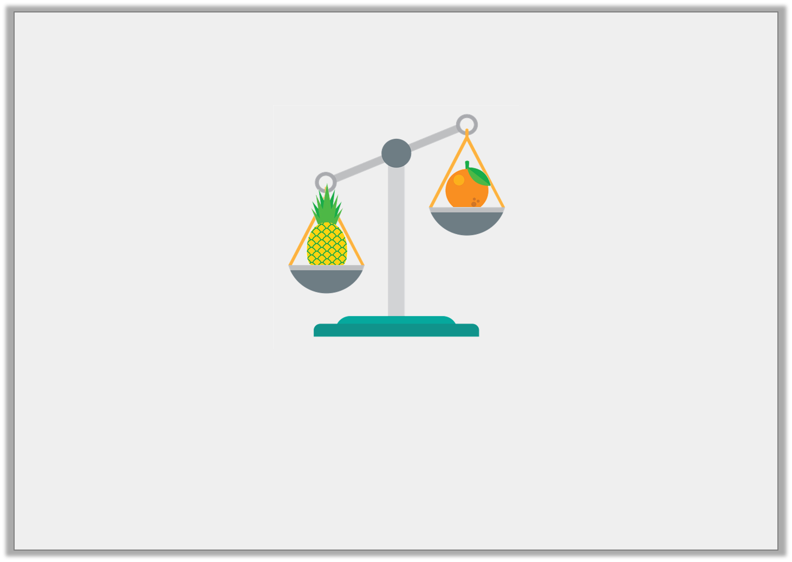
Varied Fluency 1
Tick the correct statement.
The orange and pineapple are an equal weight.
The orange is lighter than the pineapple.
© Classroom Secrets Limited 2019

Slide 5
Varied Fluency 1
Tick the correct statement.
The orange and pineapple are an equal weight.
The orange is lighter than the pineapple. | 
© Classroom Secrets Limited 2019

Slide 6
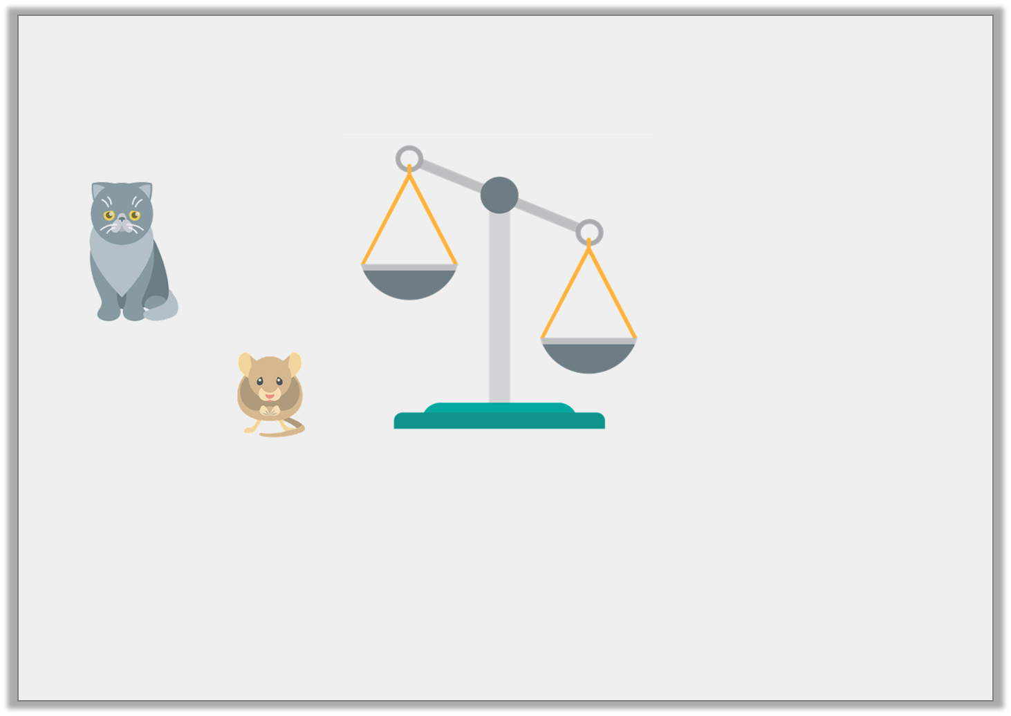
Varied Fluency 2
The cat is heavier than the mouse.
Draw them in the correct place on the scales.
© Classroom Secrets Limited 2019

Slide 7
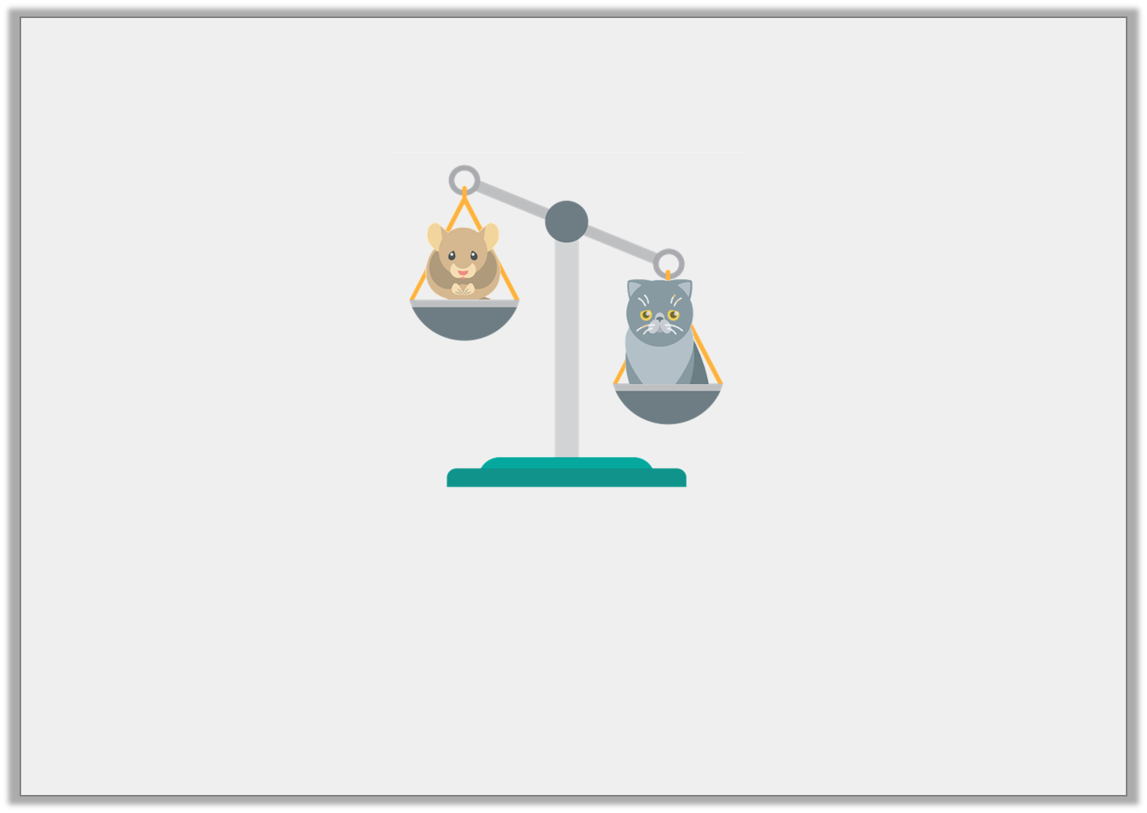
Varied Fluency 2
The cat is heavier than the mouse.
Draw them in the correct place on the scales.
© Classroom Secrets Limited 2019

Slide 8
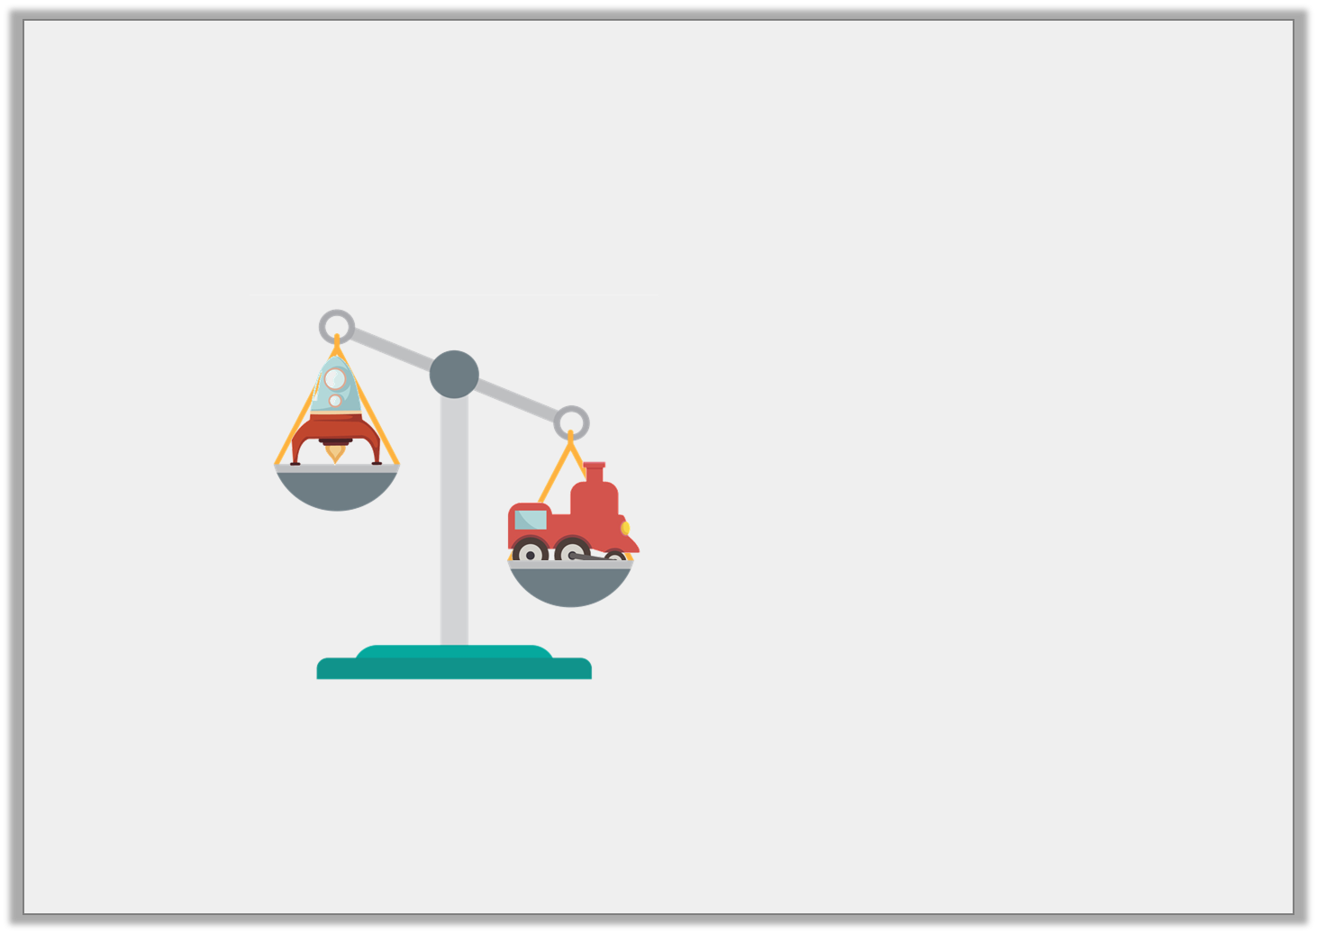
Varied Fluency 3
Circle the word that describes the weight of the rocket.
heavier
equal
lighter
© Classroom Secrets Limited 2019

Slide 9
Varied Fluency 3
Circle the word that describes the weight of the rocket.
heavier
equal
lighter
© Classroom Secrets Limited 2019

Slide 10
Varied Fluency 4
Use the scale to complete the sentence below.
The flower is ____________ than the watering can.
© Classroom Secrets Limited 2019

Slide 11
Varied Fluency 4
Use the scale to complete the sentence below.
The flower is ____________ than the watering can.
lighter
© Classroom Secrets Limited 2019

Slide 12
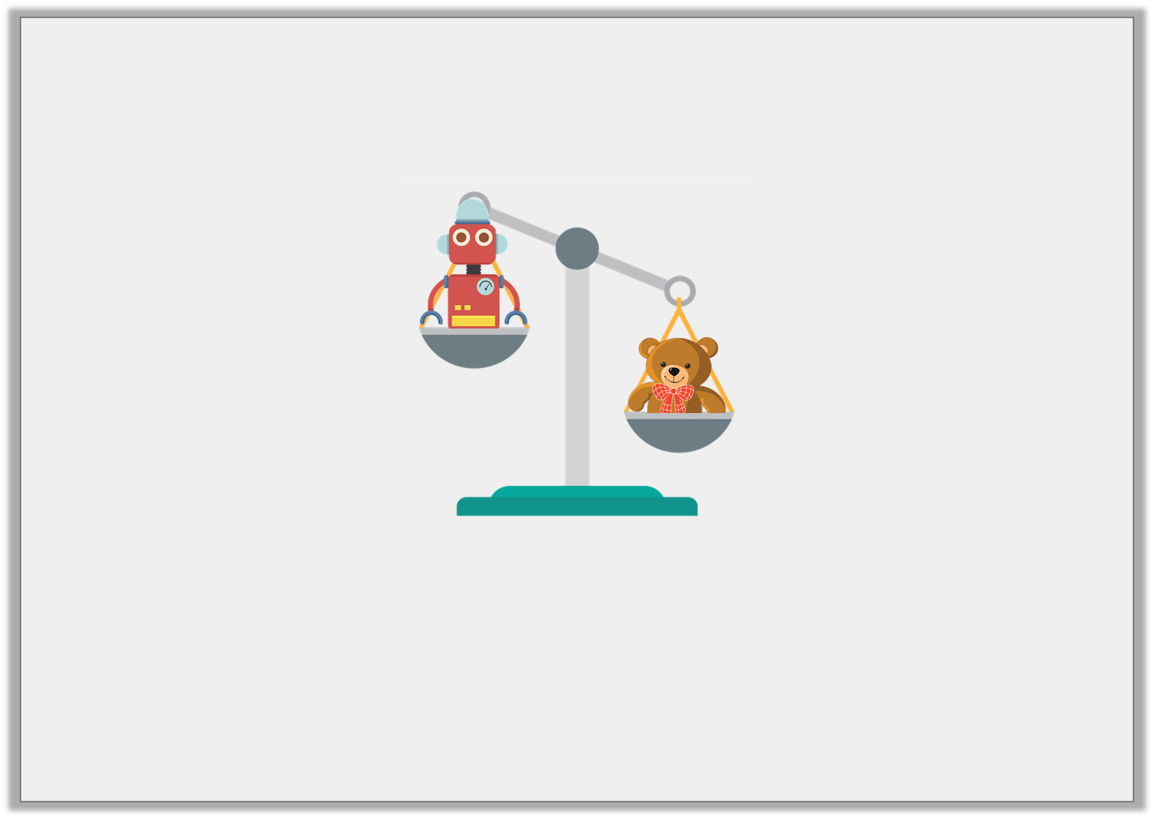
Reasoning 1
Rosie thinks the teddy bear is lighter than the robot.
Is Rosie correct? Explain your answer.
© Classroom Secrets Limited 2019

Slide 13
Reasoning 1
Rosie thinks the teddy bear is lighter than the robot.
Is Rosie correct? Explain your answer.
Rosie is incorrect because…
© Classroom Secrets Limited 2019

Slide 14
Reasoning 1
Rosie thinks the teddy bear is lighter than the robot.
Is Rosie correct? Explain your answer.
Rosie is incorrect because the teddy bear is the heaviest item.
© Classroom Secrets Limited 2019

Slide 15
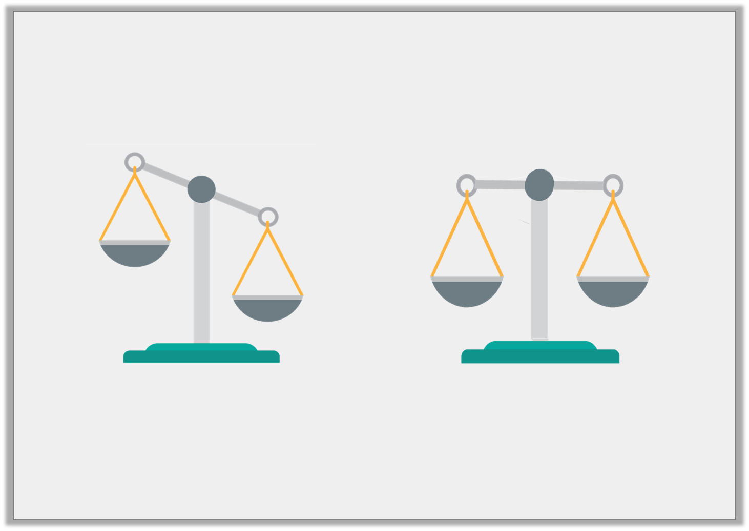
Problem Solving 1
An apple was placed on one side of the scale and a grape was placed on the other.
Would the balance scales look like A or B?
A.
B.
© Classroom Secrets Limited 2019

Slide 16
Problem Solving 1
An apple was placed on one side of the scale and a grape was placed on the other.
Would the balance scales look like A or B?
A
A.
B.
© Classroom Secrets Limited 2019

Slide 17
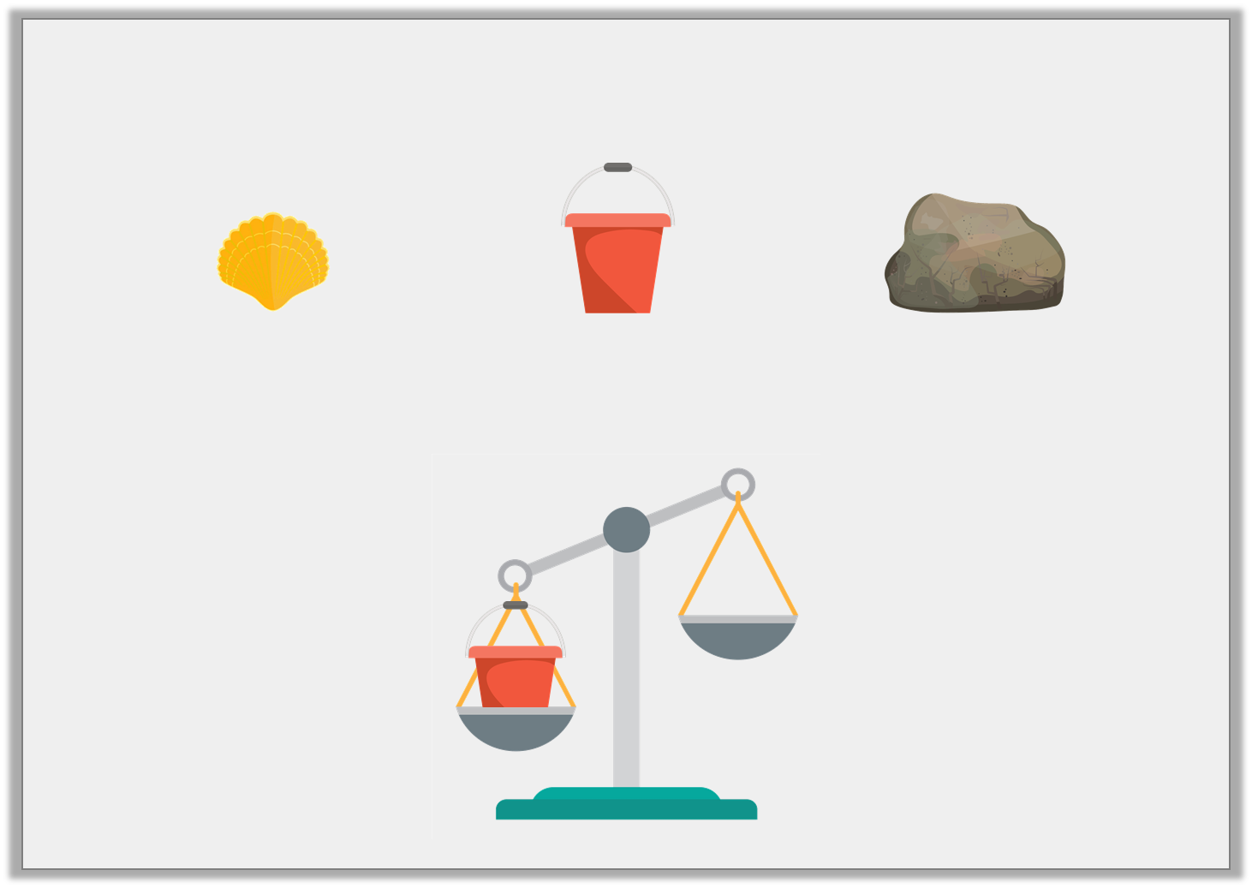
Problem Solving 2
These items have been ordered from lightest to heaviest.
Which item is missing from the scales?
A.
B.
C.
© Classroom Secrets Limited 2019

Slide 18
Problem Solving 2
These items have been ordered from lightest to heaviest.
Which item is missing from the scales?
A.
B.
C.
© Classroom Secrets Limited 2019

